Slide 1


Dangers of
Self-Deleting
JavaScript Code and
Its Real World Usage
Candidate
Edoardo Vassallo
Edo.vas@protonmail.com
Supervisor
Marina Ribaudo
Marina.Ribaudo@unige.it
University of Genova
Bachelor’s Degree in
Informatics

Slide 2
Today’s
Agenda
Self-Deletion in Malware
JavaScript and its Hurdles
  Including Code
  Deleting Code
Introducing JSRay
In The Real World
Appendix: Quirks of Open Source

Slide 3
Self-Deletion
2019
Trickbot’s Anchor_DNS
A very useful anti-debugging technique
for malware
2017
ATMitch
Later detected through digital forensics techniques
2013
Win32/Nemim.gen!A

Slide 4

What is Different
In JavaScript?
More restricted
But
More difficult to
track and study

Slide 5
What is in a Web Page?
<!DOCTYPE HTML>
<html>
<head>
<title>
“Example Web page”
</title>
</head>
<body>
<p> “Marco!” </p>
<script>
alert('Polo!');
</script>
</body>
</html>
Document
html
head
body
title
p
script
The DOM

Slide 6
Including Code
...
<div id=”example1”>
<script>
StealPassword();
</script>
</div>
...
...
<div id=”example3”>
<a
href=”javascript:Evil.js”
>
</a>
</div>
...
...
<div id=”example2”>
<body
onload=”Hack();”
>
</body>
</div>
...
...
<div id=”example4”>
<script>
eval(“CopyUsername()”);
</script>
</div>
...

Slide 7
Deleting Code
...
self.remove()
// or
self.ReplaceWith(otherNode)
// or
parent.innerHTML = “something else”
// or
parent.remove()
...

Slide 8
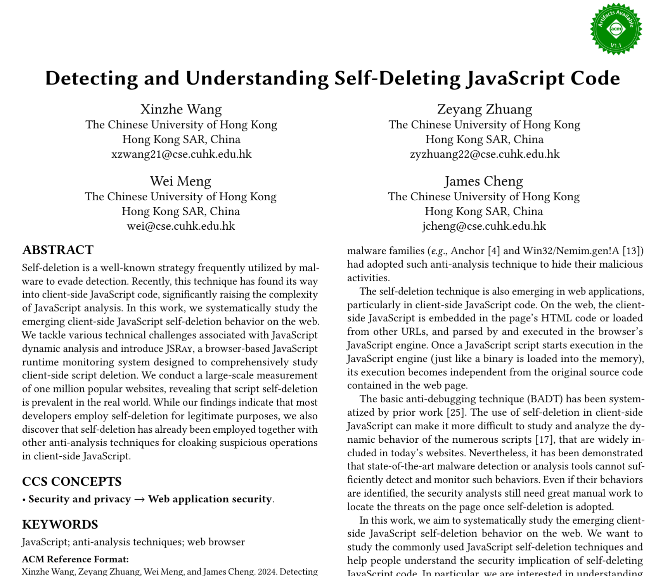
Here Comes the Cavalry

Slide 9
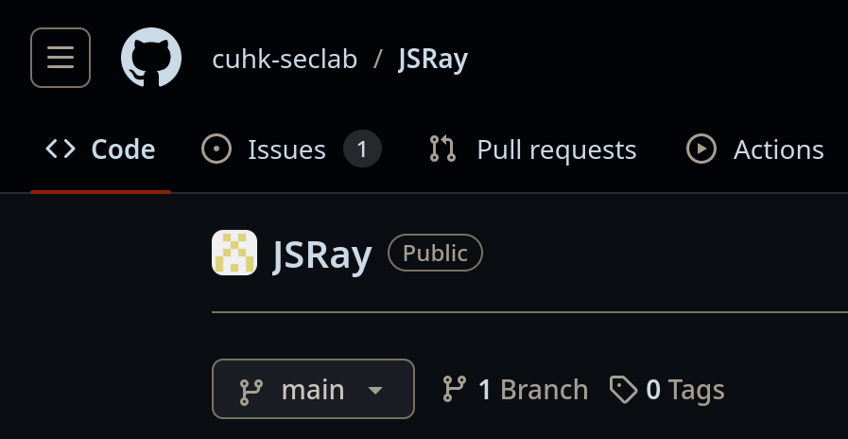
A Good
Start:
JSRay
A Chromium based tool able to detect deletions and monitor scripts relationships

Slide 10

JSRay in Action
We apply JSRay on the top one million domains in
the Tranco list
(May 2023)

Slide 11
Results of Analysis
Websites by Type
of Deletion

Slide 12
Studying Deletion
Scripts by Type of
Deletion Present
Unrelated
Deletions

Slide 13
Are They Dangerous?
 | Normal | Deleted or Deleting
Average accesses to Sensitive APIs | 2.38 | 28.12
 | Normal | Self-Deleting
Average accesses to Network APIs | 0.143 | 0.877
Percentage of scripts blocked by EasyList | 7.13% | 39.94%

Slide 14
What did we discover?
Self-Deleting Scripts are quite common
They are usually more suspicious than normal scripts

Slide 15
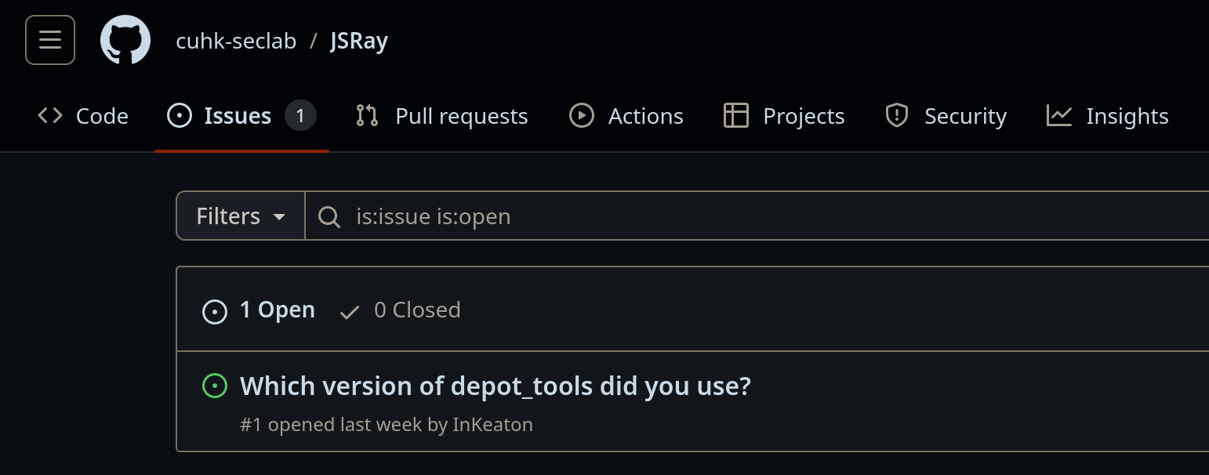
Quirks of Open Source
JSRay is currently
unusable

Slide 16
Thanks for the Attention
Any Questions?

Slide 17
References
Sitography
Double Attack: What Are Fileless Banking Attackers Really After?(last visited: 23/07/24)
Microsoft finds Trojan that hides files to evade analysis
(last visited: 23/07/24)
Dropping Anchor: From a TrickBot Infection to the Discovery of the Anchor Malware
(last visited: 23/07/24)
Self Deletion – Max Kersten
(last visited: 23/07/24)
Tranco - A Research-Oriented Top Sites Ranking Hardened Against Manipulation(last visited: 23/07/24)
Easy List
(last visited: 23/07/24)
Bibliography
Xinzhe Wang, Zeyang Zhuang, Wei Meng, and James Cheng. 2024. Detecting and Understanding Self-Deleting JavaScript Code.
In Proceedings of the ACM Web Conference 2024 (WWW ’24), May 13–17, 2024, Singapore, Singapore. ACM, New York, NY, USA, 11 pages. https://doi.org/10.1145/3589334.3645540
A. Duby, T. Taylor, G. Bloom and Y. Zhuang,
Detecting and Classifying Self-Deleting Windows Malware Using Prefetch Files.
2022 IEEE 12th Annual Computing and Communication Workshop and Conference (CCWC), Las Vegas, NV, USA, 2022, pp. 0745-0751.
https://doi.org/10.1109/CCWC54503.2022.9720874

Slide 18
Resources
Operating System
Fedora Linux 40
Fonts
Latina Essential Family
SauceCodePro Nerd Font
Office Suite
LibreOffice 24.2
Color Palette
Generated with Matugen

